Slide 1

Digital & Software
Content Capabilities
January 2026
Artificial Intelligence Led.
Human Intelligence Perfected.

Slide 3

Digital & Software - Platforms (Our Mission)
We define, design and engineer world-class digital product experiences and software using industry-leading platforms that help our clients succeed as modern digital businesses.
From strategy and design-to-build to ultra-flexible, cost-efficient run-and-scale software engineering, we transform complex, free-form digital and software ecosystems into strategic, modernized ecosystems, with gravity.
© Hexaware Technologies. Confidential briefing.
3

Slide 4
We have capabilities and expertise across various platforms, with dedicated practice looking after each genre of platforms. We cover many products across below mentioned platforms. Also, we can ramp-up or cross train our people to new product within platform very quickly.
Our Platforms Coverage
Content Management Systems (CMS)
eCommerce Platform
Customer Relation Management (CRM)
Low Code/ No Code (LC/NC)
PowerApps
Integration Platforms

Slide 5




















Content & Commerce Practice overview
300+
Full Time Consultants
50%
Certified Professionals
20+
Years of avg. leadership experience
5
Years of avg. consultant experience
Marketing & Content Platforms
Shoppable Commerce
Partnering with
Purposeful experience design
Insights driven benchmarking
Self-service experiences
Headless/microservices CMS focus
Omnichannel, multi-lingual, multi-tenant platform design and development
Data, audience, segmentation and campaign management
Hyper-personalization
Continuous optimization
Digital ergonomics (accessibility, voice enablement, visual cues, etc.)
Micro-services, API Native, Cloud enabled, Headless commerce (MACH)
Omni-channel shoppable experiences
Smart search, facets, cataloging and taxonomy enablement
Personalization, Segmentations, Analytics.
Technology rationalization
Augmenting Experience through AR/VR
Continuous optimization & enhancements

Slide 6


Our Service & Solution offerings

Slide 7









Our Solution Offering
Solutions
Management
Current State Assessment
Optimal Solution Design
Performance Gap Analysis
New Solution Implementation
Digital Marketing
Digital Asset Management
Campaign Management
Analytics
Personalization
Leverage the Product AI/ML
Platform
Activation
Marketing
Activation
Audience Planning
Content & Creative
Marketing Platform Operations
Program Optimization

Slide 8


Our Service Offerings
Strategic Consulting
Seamless Experience Design
Engineering
Transformation
Continuous Experience Delivery
Design thinking workshop
Strategy audits, benchmarking, and proofing​
Comprehensive assessment of the current ecosystem
Define omnichannel strategy​
Perform gap analysis to determine changes required to move from the current state to the optimal state
Assessments and roadmap development
Unified human-centric design​
Persona development​
Customer journeys​ mapping
Redesigning and UX revamp
Prototype development
Design prototype
Define brand guidelines
Digital marketing and content platform​ activation
Integrations with various systems & 3rd parties
Digital asset management
Data platforms and analytics​
Personalization
Platform enablement
Augmenting Experience through AR/VR​
Custom development and systems integration​
Cloud technology migration & managed support
Platform optimization & management​
content and creative production ​
Microsite, martech Campaigns and social ​
Email campaigns through CRM ​
Marketing analytics and measurement services

Slide 9

AI Accelerators

Slide 10

Content Practice - AI Accelerators
Synapse.ai (V2)
AI tool to streamline the creation of CMS components
SiteAnalyzer.ai
Provides the deep insides on Site including competitor analysis
CloudMigrator.ai
AI tool to Migration to AEM Cloud as service
Replatform.ai
Migration of pages/ site from one CMS/ non-CMS to another CMS
© Hexaware Technologies. Confidential briefing.

Slide 11

How Hexaware Synapse.AI works?
JIRA Story Creation
Specification -> Component Code
Use JIRA API to create the stories ,
Use AI LLM (Claude Sonnet) to generate component code,
Synapse.AI
UX Design -> Component Specifications
Integration into AEM
Use AI LLM (Claude Sonnet) to analyze the UX Design and business and technical specifications
Deploy component code to AEM
Can reduce the efforts by 50% to 70%
Can significantly reduce manual effort, accelerate the design-to-development process, and ensure consistency in the creation of CMS components.
Notes:
Synapse : Evokes the idea of connections and pathways within the brain, a key concept in AI

Slide 12
Hexaware Synapse.AI demo
Synapse.AI
DEMO
Notes:
Synapse : Evokes the idea of connections and pathways within the brain, a key concept in AI

Slide 13

Our Focus

Slide 14
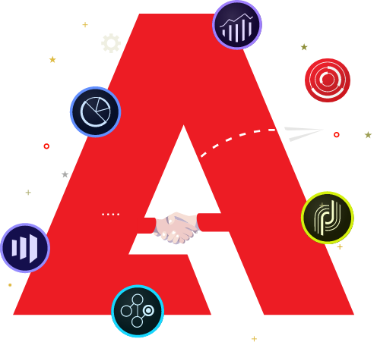
























Adobe Expertise
Adobe Clients
Not comprehensive list
Content
& Commerce
Experience Manager Sites (CMS)
Experience Manager Assets (DAM)
Adobe Commerce (Magento)
Data Insights & Audiences
Customer Journey Analytics
Audience Manager
Adobe Analytics
Real Time CDP
Digital Enrolment & Onboarding
Adobe Acrobat Sign
Experience Manger Forms
Target
Campaign
Adobe Workfront
Customer Journeys
Experience
Management Platform
Adobe Experience Platform
Sensei

Slide 15








Our Collaboration Partners
We maintain a technology and platform-agnostic approach.
Our team possesses the experience and depth of knowledge to deliver solutions across a wide range of platforms and technologies tailored to your needs.
GOLD
LEVEL PARTNER
WITH ADOBE
SILVER
LEVEL PARTNER
WITH SITECORE
BRONZE
LEVEL PARTNER
WITH DRUPAL ACQUIA
GOLD
LEVEL PARTNER
WITH SPRYKER

Slide 16














































Technology Landscape
Front End/Mobile Apps
Enablers
Digital Commerce Enablers
Marketing Automation
Digital Transactions
Web &
Mobile
Channels
Brand Awareness
Bring it all
together
Commerce
Integration
Digital Relationships
Personalize,
Track & Analyse
Enable
Commerce
Connect with
Brand
Customer Relationship
People

Slide 17

Our Engagement Models
Quality & Program Management Approach

Slide 18
Engagement Models
Outcome-Based / Value realization Pricing
Fixed Capacity PoDs
COE Based
Shared Service
  Outcomes finalized
  Budget Certainty
  Detailed Scope Upfront
  Change Management
  Fixed capacity PODs
  (Dev-only / All-Roles) –
  6 Months/1 year
  Well-defined Process for Demand Management
  Focus on capacity Utilization
  Expert guidance
  Niche skills
  On-Demand availability
  Finalized service scope & Components
  Cost effective scaling
  Service levels & SLA’s
  Security & Compliance
Certified Consultants
Periodic Review
Process & Tools

Slide 19
Our Quality Management Process
Quality Assurance Framework
This framework describes process quality and product quality which is followed through health checks, reviews, and audits
Autonomous Quality Management Group
Process Awareness
Hexaware has an autonomous group dedicated to all quality and security management activities
Awareness regarding quality and assurance is facilitated through training programs
International Standards
Quality Management
Data Privacy
Hexaware has adopted and achieved several international standards such as ISO 9001, 14001, 27001, 20000-1, SOC assessments, SEI CMM Level 5
All Hexaware processes and policies are compliant with GDPR requirements in terms of all risks and privacy factors
Quality Management System
Security Assurance Framework
Hexaware has a well-defined quality management system that addresses all management and technical processes through all the life cycle phases of project execution
This framework describes confidentiality, integrity and availability of information and services and is carried out through tests, assessments, scans, and audits

Slide 20

Process & Architecture Governance
Our Customers
Implementation Governance
  SDLC governance
  Standard & guidelines review
  Review deviation from design
  Client value adds
  Strategic direction inputs
  Establish program success with executive attention
Business, Program Manager
Hexaware PMO
Architecture Governance
Hexaware
Architect
  Architecture review
  Data model review
  Technical design review
Enterprise Architect
Process
Governance
Business Stake
Holders, Process
Leads
Hexaware
Architect,
Business Analyst
  Process design review
  Global design, localization
  Standards and guidelines

Slide 21
Program Governance
Set engagement directives
Govern: steering committee
Establish program success with executive attention
Advisory Council
Client value adds
Strategic direction inputs
Strategic
.
Executive
Sponsors
Monthly
Project reporting
Issue/risk management
Financial management
Escalation management
Change management
Operational
Program/Project Managers
Weekly
Daily scrum
Daily progress status
Queries resolution
Delivery management
Delivery
Delivery Team
Daily

Slide 22

Our Work

Slide 23











Success Stories – Content & Commerce
  Strategically integrated sub-brands into a unified platform, fostering consistent cross-brand experiences and strengthening relationships with the parent brand, augmented by analytics for optimized consumer journeys.
  Partner experience portal to create opportunities and link them to policies.
  Strategizing and delivering platform consolidation to Sitecore. .
  Enhancing product information, content, and online interaction and transactions with real-time dashboards that enable effective decision making by advisers.
  policy journey to enable improved insights for business stakeholders.
  Unify insights across multiple EY digital properties for internal and external audiences to Adobe Analytics and Customer Journey Analytics.
  Atlas, knowledge management system
  EY.ai Potal implementation for hosting all the AI solutions across EY
  Documents and Reports - download and view tracking
  Comprehensive eCommerce enablement (D2C & B2B2C) for a leading multi-brand global office furnishings manufacturer
  Implemented a cloud-based, enterprise-grade commerce platform, Magento, ensuring future scalability and extensibility
Adobe Experience Manager, Analytics. React, Boomi Integrations
Sitecore, React, unipass Integration
AEM, Adobe Guides, Analytics,
Repots
Adobe Commerce (Magento) with elastic search
  Implemented Medline’s B2B eCommerce system towards a flexible, modular architecture, designed to enhance user engagement, streamline customer acquisition, and rapidly adapt to shifting consumer behaviors, ensuring sustained market competitiveness.
  Atomic design principles and composable architecture tenets to enable business agility and consumer delight
  A Digital Experience Platform for Students, Researchers, Faculty and Alumni, powered by Adobe
  Design and implementation of an E2E DXP portal from the grounds up with UX consulting, experience design, tech architecture and enablement leveraging AEM Sites.
  Integration with Identity Management and other core applications within the university ecosystem.
  Created globalized unified platform to accelerate collaboration among users and improve the user experience and adoption of MPG services, thus leading to increased client engagement and higher market presence
  Developed persona-based content hierarchy to tailor content exposure in React application according to user personas
  Immersive Virtual Showroom Experiences For Luxury Fashion Brands, powered by Adobe
  Engineered a multi-tenant platform that facilitates the deployment of brand-specific virtual showrooms, empowering brands to deliver personalized and on-brand digital experiences.
Commerce tools, react , Google Anlytics on Azure
Adobe AEM, Adobe Analytics, Adobe Target
Sitecore with React implementation
Adobe AEM, commerce, vydyo.io , Joor integration

Slide 24



The World’s First-of-a-kind, Fully Customizable Luxury Fashion Showroom Experience for Luxury Buyers, Media and VIP’s
Fashion – A Fashion-Tech startup
Hexaware partnered with Ordre Group to design experiences and implement the Ordre Meta Digital Experience Platform. Ordre Meta, a multi-tenant immersive digitally native experience enables luxury designer brands launch customizable virtual showrooms in a few simple guided clicks that enable unique brand interaction journeys, on-brand experience, intuitive administration and themes to a URL of their choice.
The platform powers the following features.
  360-degree virtual tours & looks collections.
  Cross-platform customizations and templates to power purposeful on-brand gravity.
  Synchronized virtual and physical orders.
  Sophisticated navigation and user pathways.
  Multiple currencies and regionalization.
  AR and 3D rendering.
  VR immersive showrooms.
Winner in the
Transformation category
40+
$14Mn
$50Mn
Luxury brands onboarded
revenue generated in the 1st year
Year two projected revenue

Slide 25

Transforming End-to-End User Experience
Finance – World’s leading Financial Markets Infrastructure Provider
Our team is engaged in transforming the end-to-end user experience of all group websites by aligning with the organizational digital strategy.
In this journey, our consultants are involved in:
  Providing end-to-end solutions from design, architecture, business analysis, and Development to QA
  Handling complex integrations
  Evaluation and building search capability
  Refining content strategy
  Reimagining significant pages
  Migration of close to 6000 publicly accessible pages
  Analytics integration
The solution led to enhanced navigation, improved search functionality, easier connection to sub brand sites, well integrated tools such as RNS, Unavista, and share price tacker, seamless form submission experience with enhanced security, and accessibility compliance and additional accessibility features.
97%
Streamlined number of pages on site (from 6000+ to 170)

Slide 26


Optimizing Customer Experience with Experience Analytics and AEM Implementation
Professional Services – One of the Big Four Professional Services Firm
Optimized customer experience across every touchpoint with Analytics, Customer Journey Analytics and AEM Sites Optimization.
Unified analytics across EY's digital properties to Adobe Analytics for a holistic view of audience engagement.
Deployed Customer Journey Analytics to understand and map user interaction journeys across digital platforms.
Applied analytical insights to tailor consumer pathways to enhance consumer experience and content relevance.
Elevated digital performance by strategically optimizing website content and user journeys based on data-driven insights.
95%
10%
30%
CSAT score
Increased traffic
Digital engagement growth

Slide 27
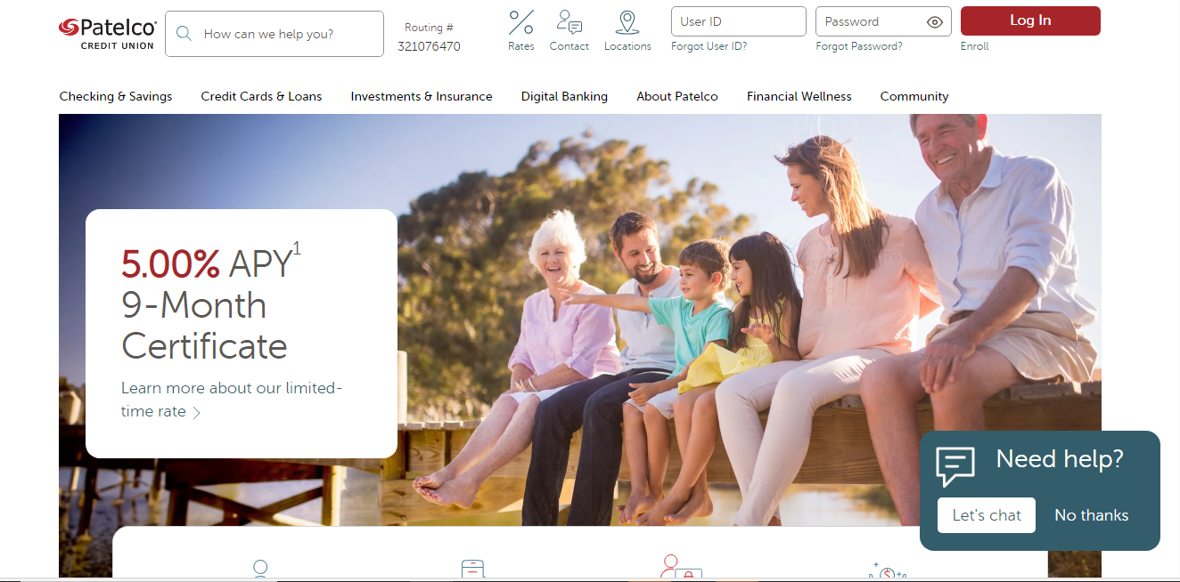


Digital Transformation through Sitecore to WordPress Migration
Patelco Credit Union
Patelco Credit Union is a full-service, not-for-profit financial cooperative dedicated to helping communities and its over 450,000 members across USA, Patelco is one of the largest credit unions in the nation.
Hexaware partnered with Patelco to transition their production site from Sitecore to a cost-effective WordPress VIP platform. The project spanned 30 weeks that included Design, Development, QA, User acceptance, and Cutover, followed by 5 weeks of Hypercare support.
This project showcased Hexaware's dedication to delivering quality and cost-effective solutions.
Benefits:
Significant Cost Savings: By migrating to WordPress VIP, Patelco achieved a substantial reduction in its TCO, freeing up resources for other strategic initiatives..
Enhanced Agility and Content Management: WordPress VIP's intuitive content management system empowers Patelco’s marketing and communications teams to easily update website content, publish new information, and respond quickly to member needs.
Enhanced Security: WordPress VIP's enterprise-grade security features provide a secure online environment for Patelco and its members
Customer Experience: Improved services for existing members and greater potential to attract new business.
Technology Stack

Slide 28

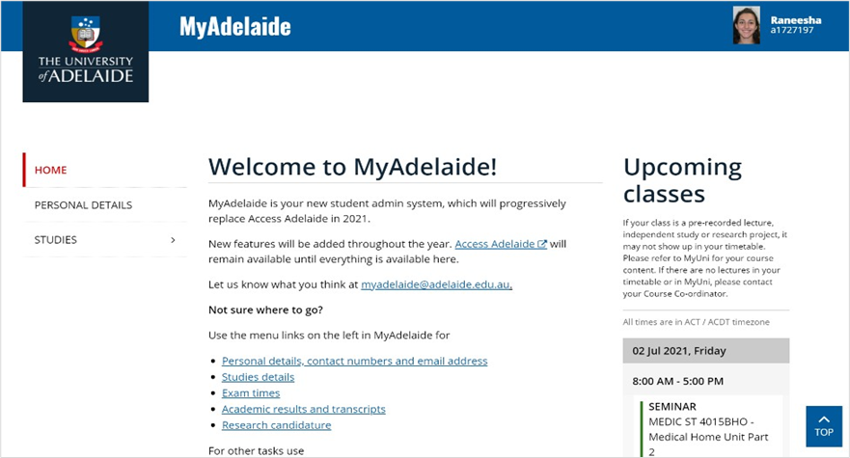



Industry :Education
Type : Case study
A Digital Experience Platform for Students, Researchers, Faculty and Alumni, powered by Adobe
Objectives​
To architect, design and enable a modern, scalable and personalized Digital Experience Platform for students, researchers, faculty and alumni, powered by Adobe
Solution​
Design and implementation of an E2E DXP portal from the grounds up with UX consulting, experience design, tech architecture and enablement leveraging AEM Sites.
Marketing Automation.
Integration with Identity Management and other core applications within the university ecosystem.
DevOps automation across the digital application portfolio.
Impact​
Technology Stack
80%
50%
30%
Growth in Engagement
Improvement in course planning
Growth in Alumni participation

Slide 29
Thank You
Please direct all inquiries to marketing@hexaware.com

Slide 30
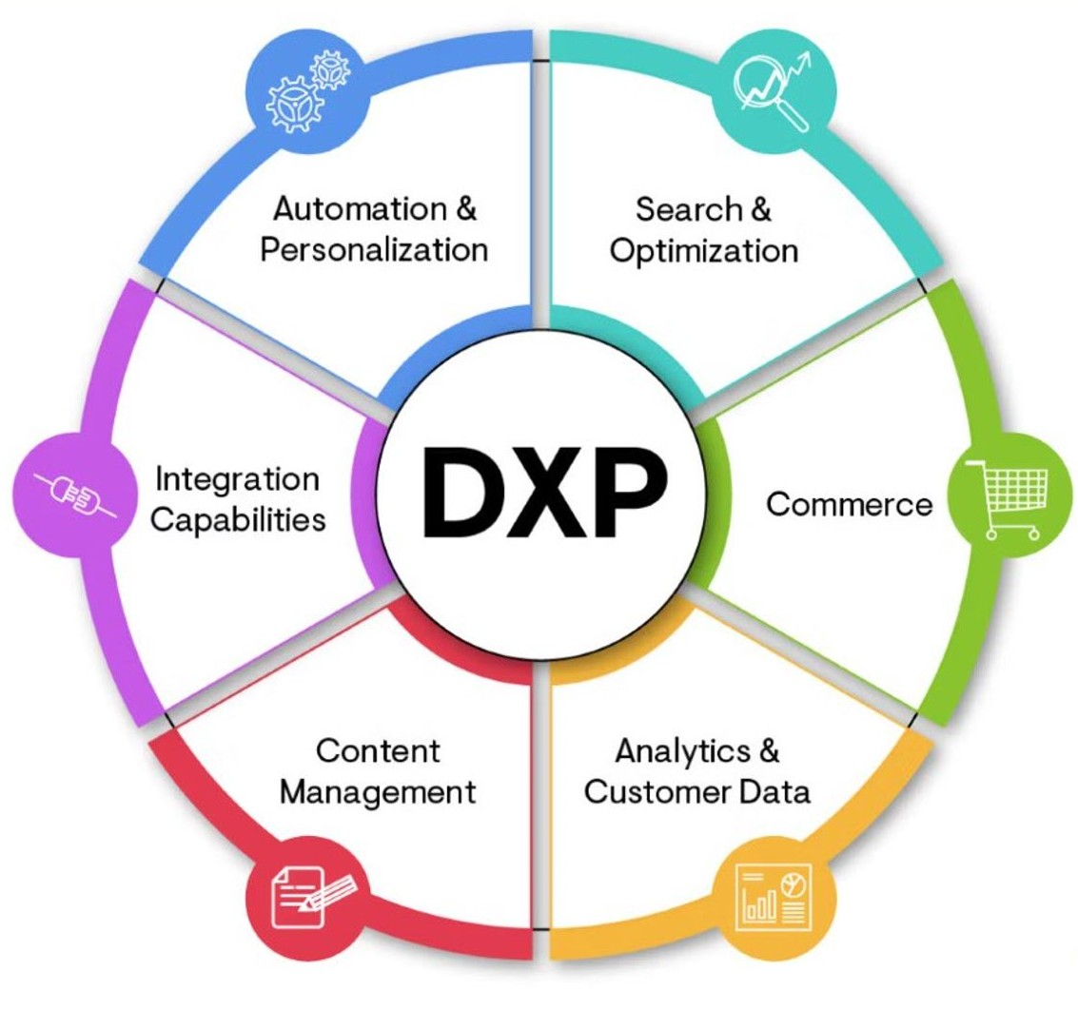






Content Management Systems (CMS)?
A CMS platform, or Content Management System, is a software application that allows users to create, manage, and modify digital content for websites and other digital platforms without needing to know how to code. Its part of Digital Experience Platforms (DXP)
Internet/ Intranet
Search
Commerce
Omnichannel
Analytics
CDP
Personalization
Campaign
Social Media
Integrations
Reports
SEO/ GEO
Themes
Implementation
Re-design
Migration/Upgrade
Marketing Operations

Slide 31
Sitecore Specific Case Studies

Slide 32




Case Study : Transforming advisers and end users digital experience
About The Client
One of the United Kingdom's largest insurance companies - LVFS
Business Objectives
Our Solution
Business Impact
  Provided Experience First design to enhance the Adviser’s and Customers engagement
  Strategized and delivered Platform consolidation on Sitecore with React for experience layer
  Created & delivered Transformation roadmap to enhance product information, content and online transactions with relevant dashboards for effective decision making
  Depicted the different phases of a policy journey to give better insights to the business stakeholders
  Created a CMS portal for end users to track their pension valuation details, account details and current status snapshot using Sitecore and microservices
  Creation of dashboard for LV advisers and business stakeholders to improve the decision-making process and reduce their lead time.
  Improve the Advisers digital experience and increase the opportunities created for them by visibility of quality protection, savings, investment & retirement products
  Create reliable, scalable & sustainably profitable digital resource, whilst remaining cost effective and flexible for business agility
  Needed a reliable channel and knowledge source for end users in pension and retirements BU
Consolidated real time view of the Protection Policy business processes
Reduced calls to customer care and streamlined business process
Manage lead time for advisors
Reduced customer and adviser service cost
Single Source of Truth for policies and documents
Effective management of customer information by Advisers for seamless communication
Enhanced end user experience with seamless self-service customer portal
Increased Site traffic by 60% resulting in improved customer adoption for the client portal
Technology Stack

Slide 33
Case Study : Transforming advisers and end users digital experience
About The Client
One of the United Kingdom's largest insurance companies - LVFS
Business Objectives
Our Solution
Business Impact
  Provided Experience First design to enhance the Adviser’s and Customers engagement
  Strategized and delivered Platform consolidation on Sitecore with React for experience layer
  Created & delivered Transformation roadmap to enhance product information, content and online transactions with relevant dashboards for effective decision making
  Depicted the different phases of a policy journey to give better insights to the business stakeholders
  Created a CMS portal for end users to track their pension valuation details, account details and current status snapshot using Sitecore and microservices
  Creation of dashboard for LV advisers and business stakeholders to improve the decision-making process and reduce their lead time.
  Improve the Advisers digital experience and increase the opportunities created for them by visibility of quality protection, savings, investment & retirement products
  Create reliable, scalable & sustainably profitable digital resource, whilst remaining cost effective and flexible for business agility
  Needed a reliable channel and knowledge source for end users in pension and retirements BU
Consolidated real time view of the Protection Policy business processes
Reduced calls to customer care and streamlined business process
Manage lead time for advisors
Reduced customer and adviser service cost
Single Source of Truth for policies and documents
Effective management of customer information by Advisers for seamless communication
Enhanced end user experience with seamless self-service customer portal
Increased Site traffic by 60% resulting in improved customer adoption for the client portal
Technology Stack

Slide 34

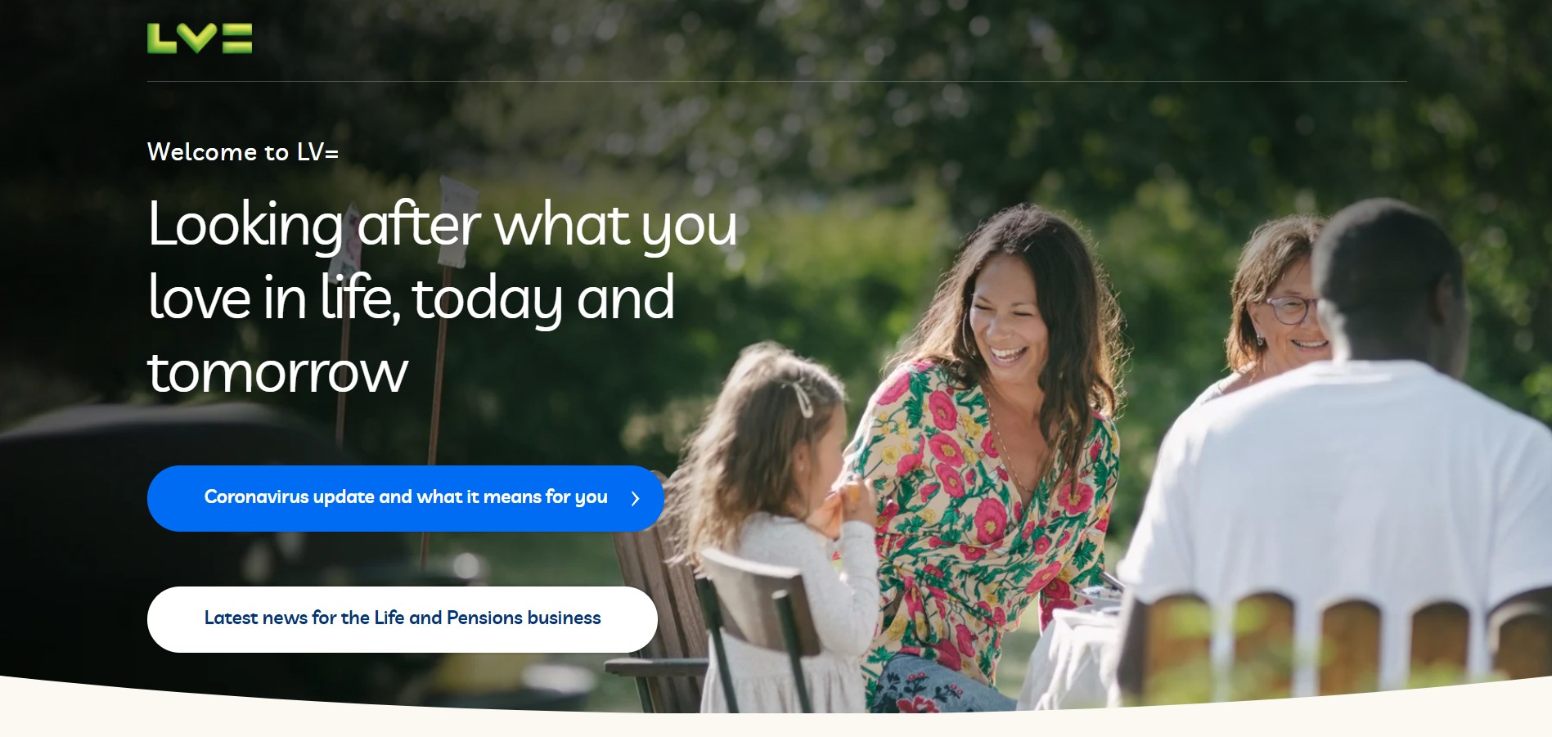




LIVERPOOL VICTORIA INSURANCE
Hexaware transforms digital insurance advisor and customer experience at Liverpool Victoria (LV=)
About Liverpool Victoria Insurance
A 180-year legacy, more than 7 million customers and 4,000 employees, Liverpool Victoria is one of UK's largest personal lines insurers. With products spanning every lifetime facet, Liverpool Victoria places customers and people at the heart of everything they do, because what matters most to them, matters to Liverpool Victoria too.
Business Challenge
LV=’s digital presence across consumer experiences, products, systems and technology endure legacy challenges.
Multiple systems of record lead to fragmented advisor and customer experience.
The system lacked real-time informative insights for rapid decision making.
High customer acquisition cost and poor digital consumer experiences.
Prolonged sales cycles with diminished customer attention.
Poor digital self-service experiences.
Solution
Hexaware transformed LV=’s digital insurance advisor and customer experience by
A new and improved React enabled interaction experience.
Strategizing and delivering platform consolidation to Sitecore.
Onboarding microservice powered integrations for resilience.
Enhancing product information, content, and online interaction and transactions with real-time dashboards that enable effective decision making by advisers.
Enriching engagement experience by depicting the different phases of a policy journey to enable improved insights for business stakeholders.
Enabling a new self-service portal to track pension valuation details, account details, and status.
Benefits
60% increase in site traffic resulting in improved adoption
3 to 1 platform consolidation across business lines
40% reduction in lead time for advisors
Self-service portal for customers
Launch of new Advisor Firm portal in 2 days
Single Source Document Library
The PPH (Protection Progress Hub) Solution
Onboarded a new online experience - Protection Progress Hub (PPH) to track and update application status information maintained across multiple systems using the common platform. PPH offers many benefits like, application status at a glance, dashboard view, filtering applications and custom dashboards that guide required actions and interventions to enable further progress.
Benefits
New Business app to call ratio reduced by over 20% in a year.
Increase in number of unique users from 2000 to 4200 in a year.
More than 2,000 policies created with 20% in saved effort.
3x increase in platform usage by advisors.
Integrations
  SendGrid – Email communication
  Java Microservices – Integration
  Layer7 SSO - Security & Authentication
  Morningstar- for External fund value feeds
  Searchstax – Search engine
  Cloudflare – DNS, caching, routing and DDoS
  Oracle Maxymiser Services – Online Customer experience
  Google Tag Services - SEO/SEM
Technology Stack

Slide 35






Case Study : Multi Brand, Multi Lingual & Omni Channel Digital Marketing Platform
About The Client
Hospitality giant with premium luxury hotels and resorts - Atlantis the Palm
Business Objectives
Our Solution
Business Impact
  Target multi-national audience representing different needs/ buying patterns
  Achieve higher booking conversion through user journey tracking across devices, environments, geographies and languages
  Monetization of information assets to generate increased revenue
  Empower business users to design scalable and powerful digital marketing experiences that personally serve multiple audiences
  Deliver content across geographies and sites through a single content management solution
  Information architecture redesign for massive reduction in translation costs
  Sitecore Business Optimization strategies implementation with massive uplift across product sales. Redesign of booking engine with responsive design resulting 5% increase in revenue
Better brand management with revamped design
793% improved restaurant reservations with visitor segmentation and offer targeting using personalization and analytics
Reduced time-to-market by 70% for new properties and offers launched
Strong digital adoption and 8% increase in member Acquisition
Upliftment in targeted MVP purchase by 217%
Technology Stack
35

Slide 36
Case Study : Multi Brand, Multi Lingual & Omni Channel Digital Marketing Platform
About The Client
American commercial real estate services company - Cushman and Wakefield
Business Objectives
Our Solution
Business Impact
  A large-sized commercial real estate brokerage company serving clients across the globe.
  Services include Consulting, Property Listing and providing though leadership with Research & Insights in the real estate market
  Having around 20+ sites, supporting 18 languages with 2000+ content pages
  Assessment of the current Digital ecosystem covering Digital Marketing and Technology landscape
  Implemented updated Information Architecture, authoring workflows, integrations with backend HR system, social feeds, Property information system etc.
  Deployed proprietary tools for keyword analysis, SEO & CRO optimization and Marketing Analytics
Digital transformation of digital assets and touch points providing localization and personalization services like multi-lingual and country specific content
The content management solution was made uniform with the right Information Governance Model
Enhanced digital marketing capabilities leading to increased traffic, lead generation, CRO etc.
Technology Stack

Slide 37

Adobe Expertise
Within the Adobe Experience Cloud suite, we offer expertise in integrating various products to form comprehensive solutions.
Analytics
Campaign
Customer Journey Analytics
Experience Manager
GOLD
LEVEL PARTNER
WITH ADOBE
Experience Manager Assets
Experience Platform
Marketo Engage
Real-Time CDP
Sensai
Target
We specialize in Adobe-enabled AI solutions, utilizing advanced technologies like generative AI. Our capabilities include generating front end code from design tools such as Figma and Adobe Firefly. Additionally, we leverage Adobe Sensei for personalized experiences.
Workfront

Slide 38
Our Focus Area – Marketing & Content Platforms
Marketing & Content Platforms
Partnering with
Purposeful experience design
Insights driven benchmarking
Self-service experiences
Headless/microservices CMS focus
Omnichannel, multi-lingual, multi-tenant platform design and development
Data, audience, segmentation and campaign management
Hyper-personalization
Continuous optimization
Digital ergonomics (accessibility, voice enablement, visual cues, etc.)

Slide 39
Considering Every Dimension
Experience Design
Mobility
Mobile-first approach through omnichannel enablement with E2E strategy and solution partnership accelerated via composability and MACH
strategy
Cloud
innovation
Shoppable
Experiences
Marketing & Content Platforms
Data & Analytics
Marketing Services

